Slide 1

Machine Learning based Phishing Website URL Detection
Team No:13
Under the guidance of Mrs. Y. Prathima
Assistant Professor CSE DEPT
P.Sai Rahul (178R1A05G4)
G.Rahul Yadav (178R1A05D3)
P.Sai Roshan (178R1A05H0)
K.Rukmini Reddy (178R1A05E6)

Slide 2
Abstract
There are a number of users who purchase products online and make payment through e- banking. There are e-banking websites who ask users to provide sensitive data such as username, password & credit card details etc., often for malicious reasons. This type of e-banking website is known as a phishing website.
Web service is one of the key communications software services for the Internet. Web phishing is one of many security threats to web services on the Internet. This Project mainly focuses on applying a machine learning algorithm to detect Phishing websites.

Slide 3

Introduction
Phishing imitates the characteristics and features of emails and makes it look the same as the original one. It appears similar to that of the legitimate source. The user thinks that this email has come from a genuine company or an organization. This makes the user to forcefully visit the phishing website through the links given in the phishing email.

Slide 4

Introduction(Cont.)
These phishing websites are made to mock the appearance of an original organization website.
The phishers force user to fill up the personal information by giving alarming messages or validate account messages etc. so that they fill up the required information which can be used by them to misuse it. They make the situation such that the user is not left with any other option but to visit their spoofed website.

Slide 5
Literature Survey
Wong, R. K. K. (2019). An Empirical Study on Performance Server Analysis and URL Phishing Prevention to Improve System Management Through Machine Learning.
Rao, R. S., & Pais, A. R. (2019). Jail-Phish: An improved search engine based phishing detection system.
Ding, Y., Luktarhan, N., Li, K., & Slamu, W. (2019). A keyword-based combination approach for detecting phishing webpages.
Marchal, S., Saari, K., Singh, N., & Asokan, N. (2016, June). Know your phish: Novel techniques for detecting phishing sites and their targets.
Shekokar, N. M., Shah, C., Mahajan, M., & Rachh, S. (2015). An ideal approach for detection and prevention of phishing attacks.

Slide 6
Existing System
List-based phishing detection systems use two list, whitelists and blacklists, for classifying the legitimate and phishing web pages.
Whitelist-based phishing detection systems make secure and legitimate websites to provide the necessary information.
Each website that is not in the whitelist is considered as suspicious.

Slide 7
Existing System Limitations
The blacklist-based systems, however, do not have the ability to detect an actual attack or a ﬁrst-time attack (zero-day attack). These attack detection mechanisms have a lower false positive rate than machine learning based systems. The success of the blacklist-based phishing attack detection system is about 20%.

Slide 8
Proposed System
We proposed an intelligent, flexible and effective system that is based on using classification algorithms. We implemented classification algorithms and techniques to extract the phishing datasets criteria to classify their legitimacy.
The e-banking phishing website can be detected based on some important characteristics like URL and domain identity, and security and encryption criteria in the final phishing detection rate.

Slide 9
Proposed System Advantages
Real-time Execution
Detection of new Websites
Independence from Third-Party Services
Ease of access
Better performance

Slide 10
Software Requirements
Operating Systems : Windows 7 , 8 and 10
IDE : Pycharm
Programming Languages : Python
Framework : Flask
software/packages : Anaconda Navigator ,Sklearn,NumPy ,Pandas, Matplotlib

Slide 11
Hardware Requirements
Processor : intel core i3(minimum)
Speed : 1.8 Ghz (min)
RAM : 2 GB(min)
Hard Disk : 50GB
Key Board : Standard Windows Keyboard
Mouse : Two or Three Button Mouse
Monitor : SVGA

Slide 12
Findings of the project(Technique used)
Identify the criteria that can recognize fake URLs
Train our model to recognize fake vs real URLs
Evaluate our model to see how it performs
Check for false positives/negatives

Slide 13
Algorithm
We considered the logistic regression model for this project.
Regression algorithms predict the output values based on input features from the data fed in the system.
The go-to methodology is the algorithm builds a model on the features of training data and using the model to predict the value for new data.
We will be using the test set for evaluation.
The test set is given to the model for prediction and prediction values are stored in another variable called y_pred1.

Slide 14
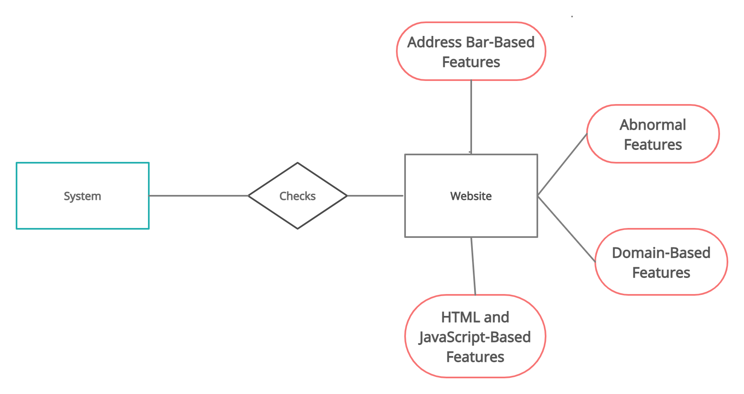
ER Diagram

Slide 15
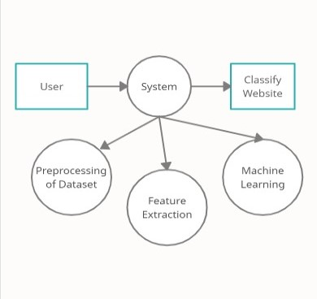
Data Flow Diagram

Slide 16
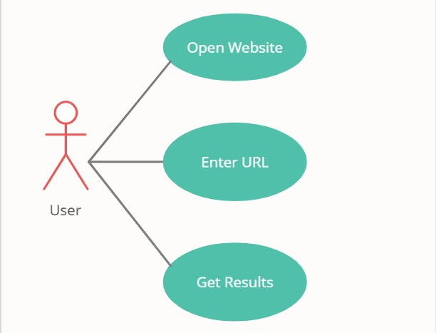
UML Diagram

Slide 17
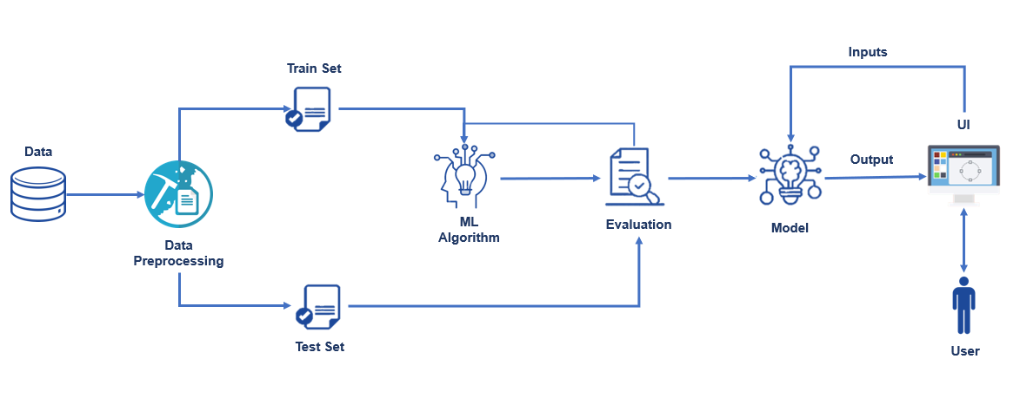
System Architecture

Slide 18
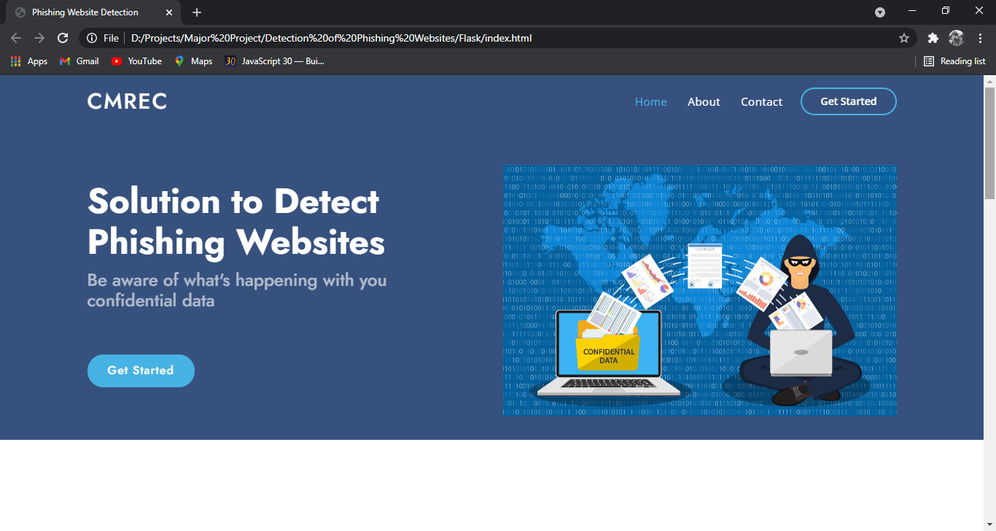
Output Screenshots

Slide 19
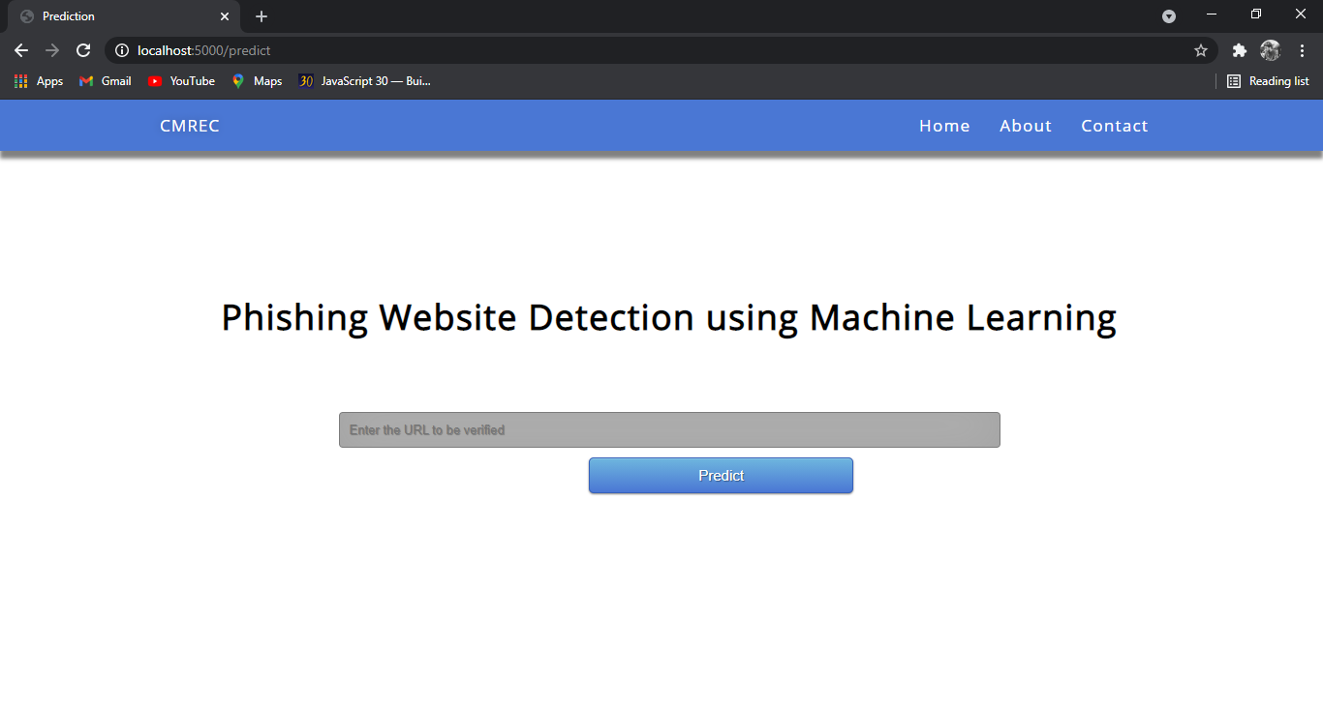
Output Screenshots

Slide 20
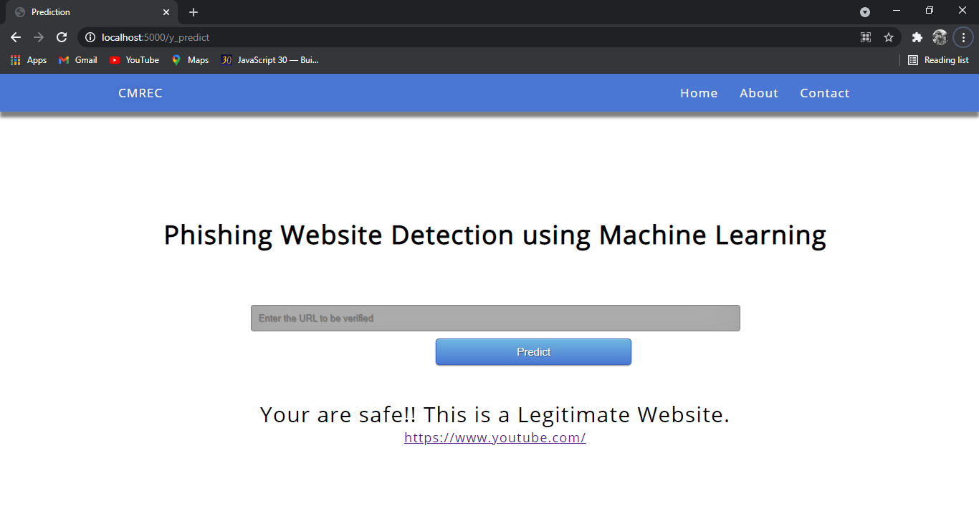
Output Screenshots

Slide 21
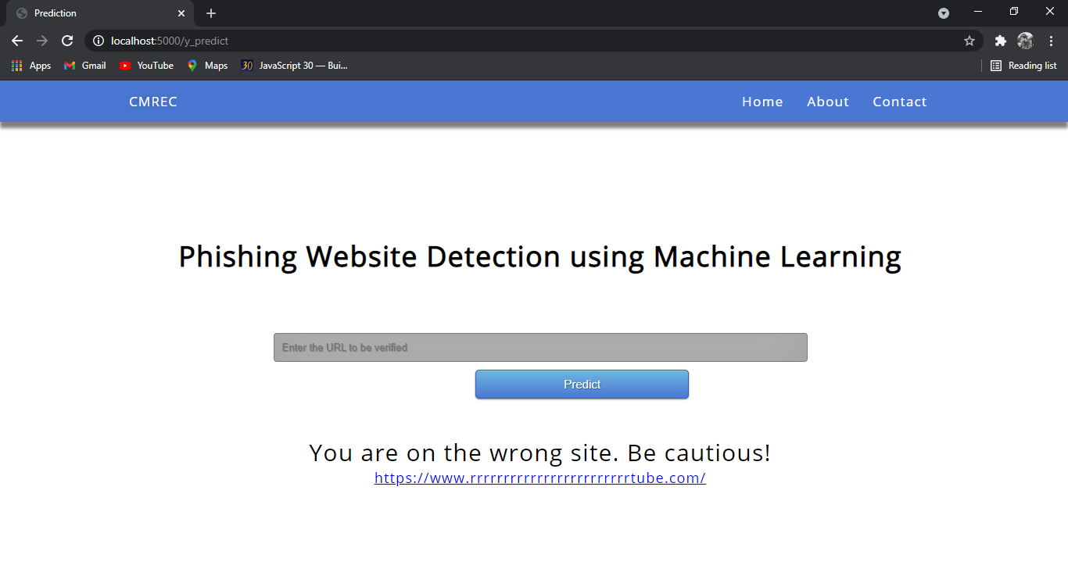
Output Screenshots

Slide 22
Conclusion
It is found that phishing attacks is very crucial, and it is important for us to get a mechanism to detect it. As very important and personal information of the user can be leaked through phishing websites, it becomes more critical to take care of this issue.
This problem can be easily solved by using any of the machine learning algorithm with the classifier. We have seen that existing system gives less accuracy, so we proposed a new phishing method that employs URL based features and also, we generated classifiers through machine learning.

Slide 23
Future Enhancements
In future if we get structured dataset of phishing, we can perform phishing detection much faster than any other technique.
We can use a combination of any other two or more classifier to get maximum accuracy. We also plan to explore various phishing techniques that uses Lexical features, Network based features, Content based features, Webpage based features and HTML and JavaScript features of web pages which can improve the performance of the system.
Dynamic integration with real time websites.

Slide 24
Thank You!

